Slide 1

INFO 6210 Group 13
DB
-XINYUE ZHANG
-FENG ZHAO

Slide 2

Database Design
Topic
Objectives
ERD

Slide 3
Topic
Online loan investment management
Purpose:
The purpose of the database is to maintain the data of loans’ information generated from the P2P investment online platform. This database can be used by borrowers and investors to see more detailed and systematically organized information of borrowers and loans (including listing loans and history records).

Slide 4
Objectives
Investors:
Data on investors
Data on investing history
Borrowers:
Data on borrowers
Data on borrowing history
Loan Data:
loan information

Slide 5
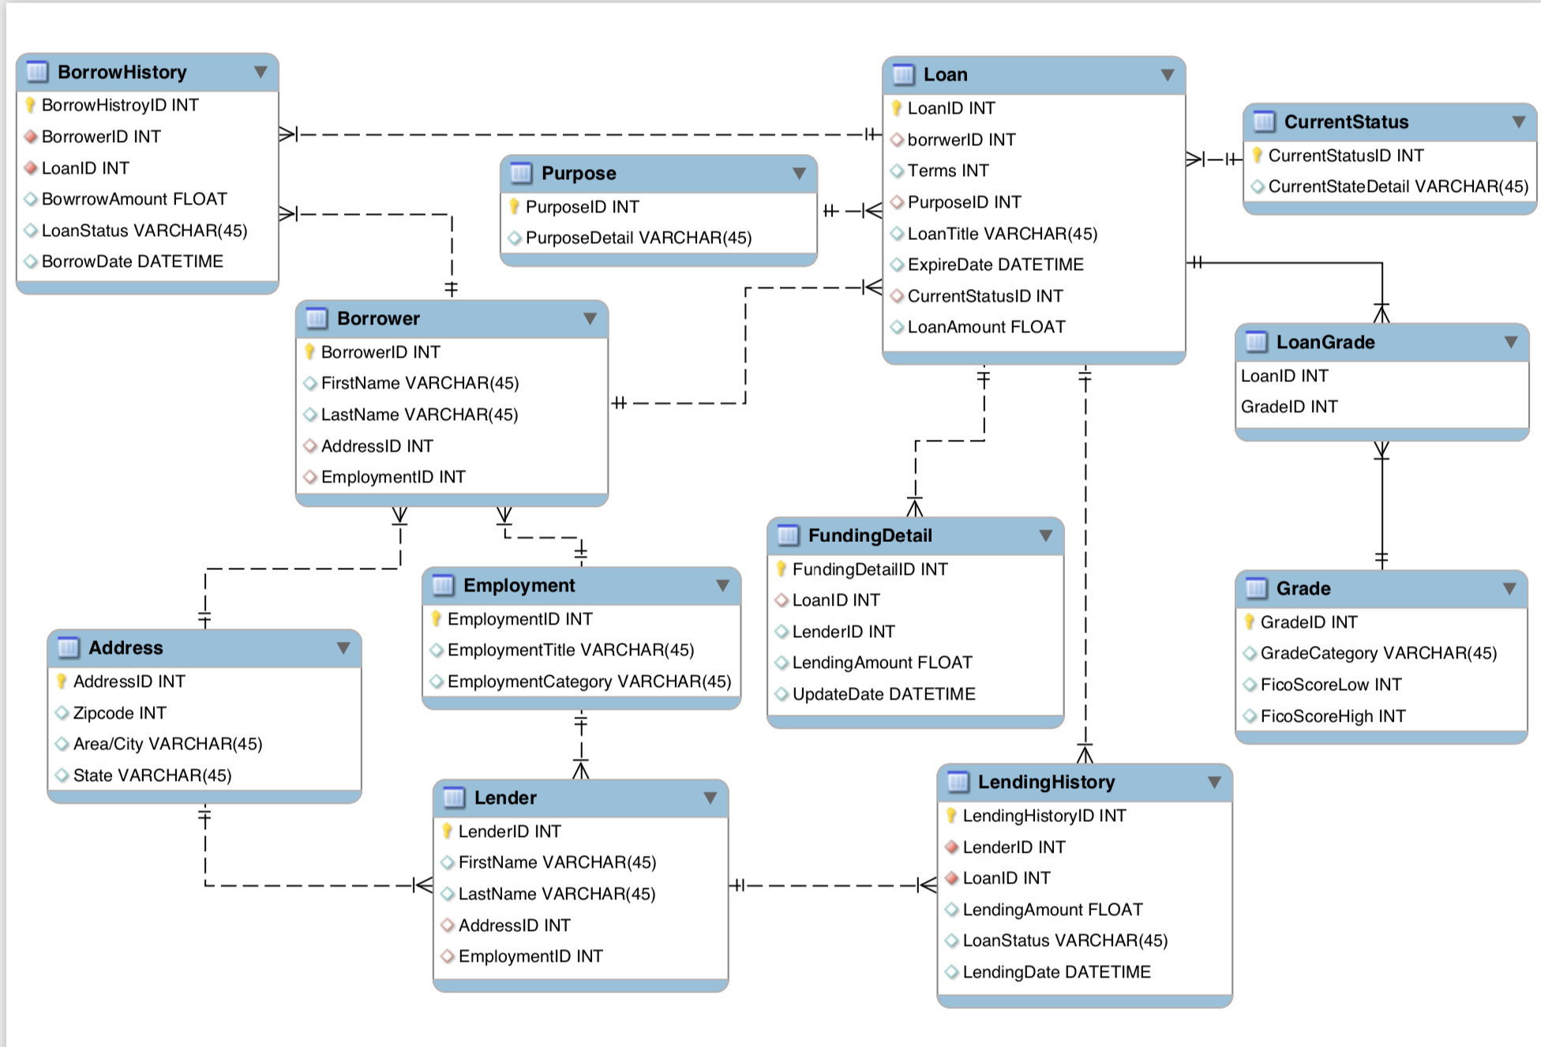
ERD

Slide 6
Database Implementation
Highlights

Slide 7
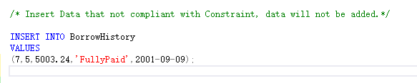
Table Level Constraint
Business Purpose:
Regional financial crisis emerged in St. Louis Area, to be compliant with risk management, the business need to block any user who live in that area from lending.
Implementation:
Add a table level constraint which prevent insert data into borrow history, while keep all the user information intact no matter where the user belongs.

Slide 8
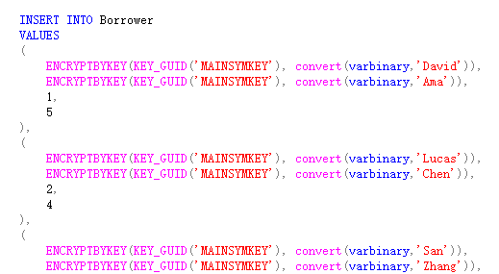

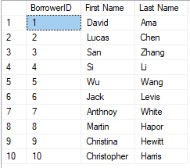
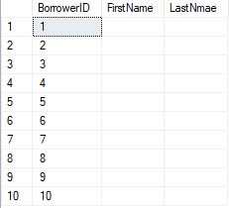

Column Level Encryption
Business Purpose:
The business treats the borrower and lender names as critical assets. The leakage on those information will bring up serious legal issue and benefit other competitors
Implementation:
Encrypt the names using Symmetric key and certificates. During the incidents, e.g. a data breach, the intruder won’t be able to get the names.

Slide 9
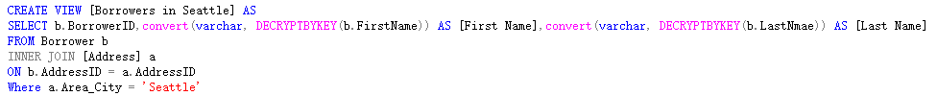

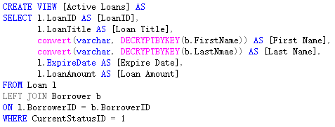
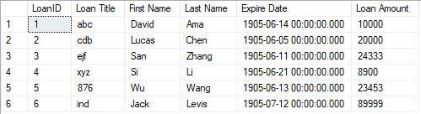
SQL VIEW

Slide 10
Sample Reports/Dashboard
Generated By PowerBI

Slide 11
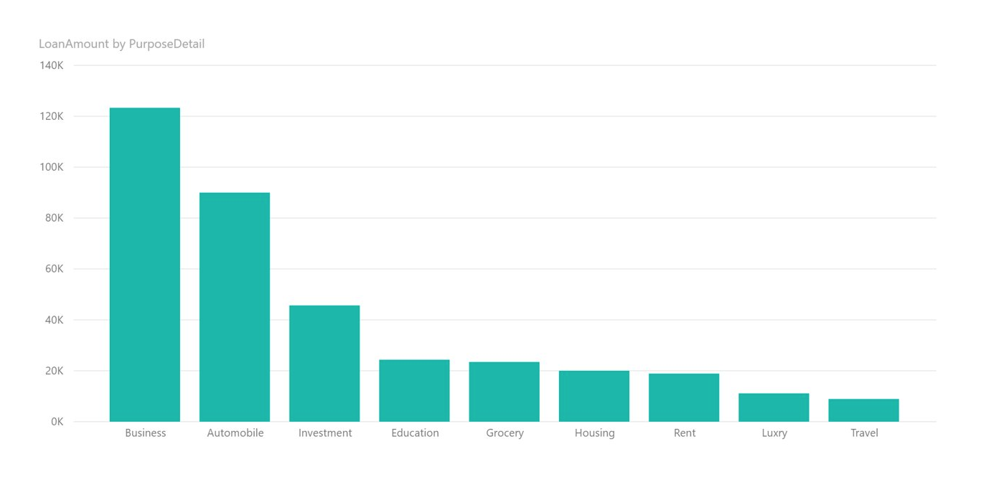
Loan Amount

Slide 12
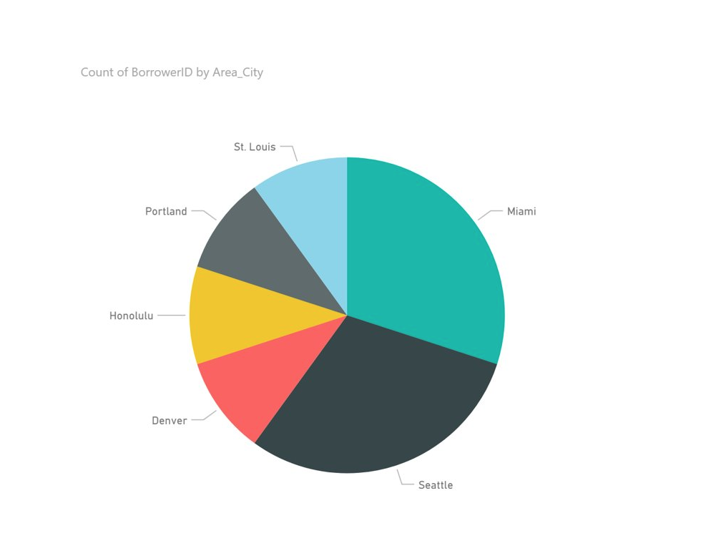
Borrower Area

Slide 13
Thanks
DB

